Slide 1


JFF’s National Innovation Hub for Diversity, Equity, Inclusion, and Accessibility in Registered Apprenticeship
JFF’s National Innovation Hub for Diversity, Equity, Inclusion, and Accessibility provides strategies and customized support to employers, education providers, intermediaries, and government entities to drive diversity, equity, inclusion, and accessibility in Registered Apprenticeship.
Our goal is to improve Registered Apprenticeship access and outcomes for all women, people of color, people with disabilities, workers who live in rural communities, people who identify as LGBTQ+, and individuals who have been involved with the criminal justice system.
The Innovation Hub is a United States Department of Labor Registered Apprenticeship Technical Assistance Center of Excellence and is operated by JFF’s Center for Apprenticeship & Work-Based Learning.
Learn more at jff.org/apprenticeshipdeia

Slide 2










JFF’s National Innovation Hub for Diversity, Equity, Inclusion, and Accessibility in Registered Apprenticeship

Slide 3

ABOUT THE HUB
JFF’s National Innovation Hub for Diversity, Equity, Inclusion, and Accessibility in Registered Apprenticeship
JFF’s National Innovation Hub for Diversity, Equity, Inclusion, and Accessibility provides strategies and customized support to employers, education providers, intermediaries, and government entities to drive diversity, equity, inclusion, and accessibility in Registered Apprenticeship. Our goal is to improve access and outcomes for all women, people of color, people with disabilities, workers who live in rural communities, people who identify as LGBTQ+, and individuals who have been involved with the criminal justice system.
The Innovation Hub is a United States Department of Labor Registered Apprenticeship Technical Assistance Center of Excellence and is operated by JFF’s Center for Apprenticeship & Work-Based Learning.

Slide 4

Deia innovation hub
Our Vision
We envision a world where all Americans—regardless of race, ethnicity, gender, ability, religion, national origin, sexual orientation, socioeconomic background, or location—have equal access to Registered Apprenticeship, leading to career advancement and economic mobility.

Slide 5




Deia innovation hub
We do this by:
Our Mission
Advancing employer efforts to build diverse, equitable, inclusive, and accessible Registered Apprenticeship programs
Building partnerships to create sustainable change in Registered Apprenticeship programs
Informing systems and policy change by elevating promising and innovative practices that advance diversity, equity, inclusion, and accessibility in Registered Apprenticeship
We drive changes in the Registered Apprenticeship system that increase diversity, equity, inclusion, and accessibility for populations that have not had access to the promise of apprenticeship.

Slide 6




Assess and support organizational readiness in implementing practices to improve diversity, equity, inclusion, and accessibility in a Registered Apprenticeship program
Implement customized diversity, equity, inclusion, and accessibility strategies for recruitment, mentorship, related instruction, and retention services at Registered Apprenticeship employers and their partners
Integrate data and apprentice voice within the design of Registered Apprenticeship programs
Build the capacity of intermediaries, community-based organizations, and educational partners to effectively engage in building equitable Registered Apprenticeship opportunities
Deia innovation hub
Our Approach
To establish diverse, equitable, inclusive, and accessible Registered Apprenticeships, youth apprenticeships, and high-quality pre-apprenticeships, the Innovation Hub works with employers, intermediaries, community-based organizations, educational partners, workforce boards, and government agencies to:

Slide 7





DEIA Definitions
Diversity
The representation and proactive valuing of varied identities, differences, and perspectives, honoring our lived experiences collectively and individually.​
Equity
Intentional distribution of access and resources to remove the predictability of success or failure that correlates with entrenched outcome disparities in our society.​
Inclusion
The creation of a culture
of belonging that prioritizes the contribution and participation of all people in executing an organization’s mission, values, and goals.​
Accessibility
The facilitation of full and independent access for all people to employment, facilities, services, and information through intentional design, development of accommodations, and respect for the wide range of human ability.
Diversity: The representation and proactive valuing of varied identities, differences, and perspectives, honoring our lived experiences collectively and individually.​
Equity: Intentional distribution of access and resources to remove the predictability of success or failure that correlates with entrenched outcome disparities in our society.​
Inclusion: The creation of a culture of belonging that prioritizes the contribution and participation of all people in executing an organization’s mission, values, and goals.​
Accessibility: The facilitation of full and independent access for all people to employment, facilities, services, and information through intentional design, development of accommodations, and respect for the wide range of human ability.

Slide 8
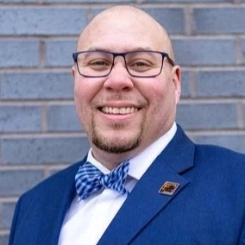
Joshua is a director in JFF’s Center for Apprenticeship & Work-Based Learning, where he focuses on expanding access to career pathways in apprenticeship for women, people of color, and other populations underrepresented in the workforce.
Prior to JFF, Joshua was the state director of the Wisconsin Apprenticeship System, which encompassed youth and Registered Apprenticeship and certified pre-apprenticeship programs.
Joshua Johnson
Director, JFF
Notes:
Joshua's connection to Apprenticeship goes back to his participation and completion of a Construction Craft Laborer apprenticeship in 2007 and worked as a Journeyworker for the next 3 years.

Slide 9


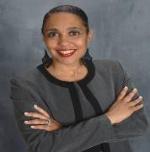

Ginger Allison
Director
Jennifer Meier
Senior Program Manager
Maji Tharpe
Director
Mariela Renquist
Program Manager

Slide 10




Vacant
CAWBL VP
Rachel Crofut
Associate Director, Communications
Myriam Sullivan
CAWBL Interim Vice President
Lena Kassicieh
Communications Manager
Vanessa Bennett
CAWBL Director

Slide 11







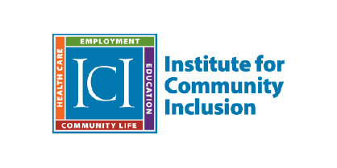
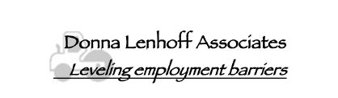
Our partners
Notes:
Josh

Slide 12

Current State
DEIA in Registered Apprenticeship

Slide 13
Why the DEIA Framework is Necessary:
A Snapshot of Apprenticeship Equity
Efforts to boost participation are working, but systemic changes are needed to drive equitable outcomes for all.
81%
76%
2010
2019
13%
17%
1%
1%
0%
1%
2%
2%
3%
2%
*White
Native Hawaiian or Other Pacific Islander
Two or more races
Black or *African American
*Asian
Alaska Native/ *American Indian
*JFF is committed to using language that promotes equity and human dignity. These classifications were provided by the U.S. Department of Labor and we have used them here for data consistency.
Source: https://blog.dol.gov/2021/11/03/equity-snapshot-apprenticeships-in-america

Slide 14
Average Apprenticeship Completion Rates 2010-2019
Differences in completion rate expose structural and systemic inequities that are disproportionately affecting Black apprentices.
Source: https://blog.dol.gov/2021/11/03/equity-snapshot-apprenticeships-in-america
Notes:
Maria

Slide 15

Moving Forward
Support and Resources

Slide 16


Advancing DEIA in Registered Apprenticeship
The program design framework offers employers and registered apprenticeship sponsors field-informed program design elements and considerations for building systems, processes, partnerships, and practices that can drive DEIA in RA. They are informed by existing evidence and data as well as extensive research and work with employers, sponsors, intermediaries, and practitioners in the field.

Slide 17










Organizational Conditions to Support Success
≈ç
Recruitment
Livable wages & advancement opportunities
Leadership and staff diversity
Accessible and representative instruction
Partnerships
Participant voice & culture of belonging
Quality Mentorship
Employer Readiness
Employer Structure
External Organizations
Equitable data practices
Retention Services

Slide 18


Use Transparent and Accessible Practices to Diversify Recruitment
The first interaction apprentices will have with an apprenticeship program will occur during outreach and recruitment. To ensure that programs are equitable, inclusive, and accessible, outreach practices and materials should be shared with a range of communities and in ways that allow for different forms of engagement and interaction.
Notes:
Daniel
It lays out several aspirational characteristics of high-quality programs and emphasizes designing for equity and access by focusing on things like transparency with respect to entry and success requirements, and wrap around services and supports
JFF has adapted this framework further into two additional iterations. One is focused on program development in the IT industry, and another looks at effective practices for building pre-apprenticeship programs that serve and support opportunity youth, or young adults that face significant barriers to the labor market.

Slide 19
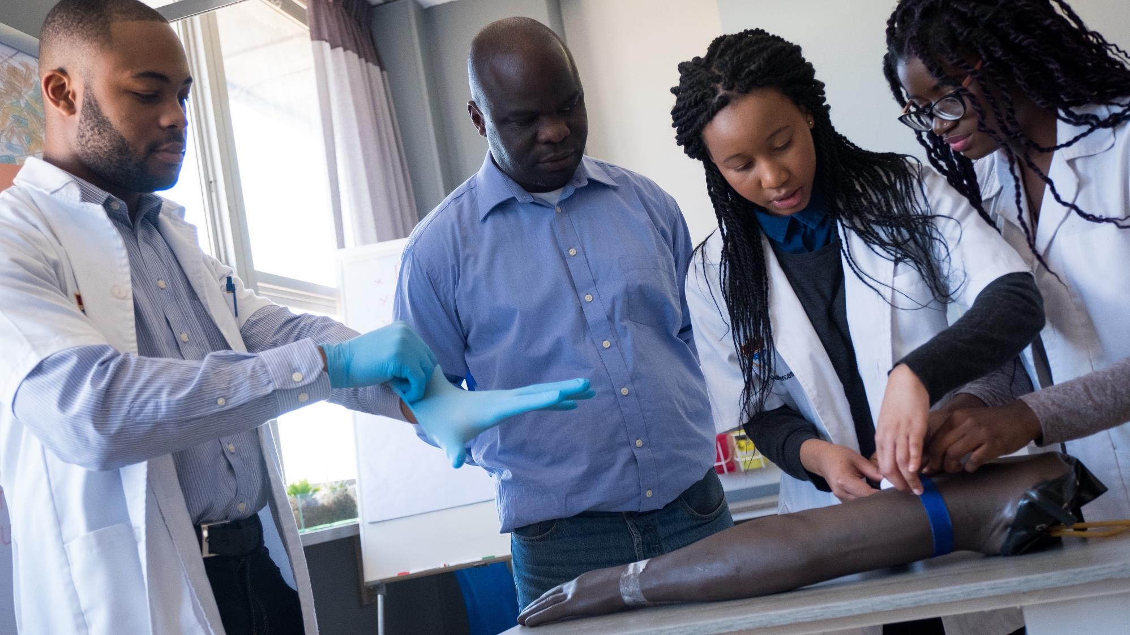

Design Training and Classroom Instruction to be Accessible and Representative of Participants
Equitable apprenticeships not only get people from a wide range of backgrounds in the door, but they also set up each apprentice for success throughout the program and beyond. To achieve this and ensure all participants can benefit, programs must design training and classroom instruction to be accessible to everyone regardless of learning needs or preferences or physical ability. It is equally important that on-the-job training and classroom environments and instruction represent program participants.
Notes:
Daniel
It lays out several aspirational characteristics of high-quality programs and emphasizes designing for equity and access by focusing on things like transparency with respect to entry and success requirements, and wrap around services and supports
JFF has adapted this framework further into two additional iterations. One is focused on program development in the IT industry, and another looks at effective practices for building pre-apprenticeship programs that serve and support opportunity youth, or young adults that face significant barriers to the labor market.

Slide 20


Provide Comprehensive and Quality Mentorship to Participants
Mentorship in Registered Apprenticeship helps participants learn the details of their occupation and workplace while providing coaching and guidance to support them in their training. Mentors can expose participants to advancement opportunities, foster career exploration, and create a culture of inclusion.
Notes:
Daniel

Slide 21

Support Participant Success With Robust and Responsive Retention Services
Apprentices will not fully access the value and opportunity of an apprenticeship unless they can complete their training. Employers, RA sponsors, and those designing programs should invest in removing barriers to completion to ensure all apprentices can successfully complete.
Notes:
Daniel

Slide 22


Incorporate Participant Voice Authentically and Build Cultures of Belonging
Work and training environments that reflect and support participants’ different needs and experiences can drive DEIA in RA. RA programs are intensive, and completion is a challenge across all demographic groups. When organizations consistently and authentically incorporate apprentice feedback into program design and create a sense of belonging, apprentices feel more invested in, connected to, and supported by their training, which can help improve persistence and completion.
Notes:
Daniel

Slide 23



How can the Innovation Hub support you?
Employers, Sponsors & Industry Intermediaries
Educational Institutions & Community Based Organizations
Government & Workforce Development
Diversifying talent pipeline
Program design to drive equitable outcomes
Facilitate partnerships to strengthen DEIA efforts
Support implementation of EEO regulations
Drive policy change to diversify apprenticeships
Funding strategies to bolster equitable access and outcomes in RA
Tools and capacity building for staff at state apprenticeship agencies, workforce boards, and other relevant government entities that can drive adoption of equitable practices in RA
Facilitate partnerships to drive equitable RA program development
Employer engagement
Youth Apprenticeship development & implementation supports
Notes:
Josh
Ask to launch Poll

Slide 24
NATIONAL INNOVATION HUB FOR DEIA IN RA
Take Your Next Step
Access
our Resources
Learn more about DEIA strategies in apprenticeship, EEO regulations and more.
Request Technical Assistance
Meet with our team to explore resources, upcoming group technical assistance, or individual coaching.
Sign the Pledge
Make a commitment to strengthen your organization through Equitable Apprenticeship.
Visit jff.org/apprenticeshipdeia
Notes:
Josh

Slide 25
Organizational Conditions to Support Success
≈ç
Recruitment
Livable wages & advancement opportunities
Leadership and staff diversity
Accessible and representative instruction
Partnerships
Participant voice & culture of belonging
Quality Mentorship
Employer Readiness
Employer Structure
External Organizations
Equitable data practices
Retention Services

Slide 26


Customized Technical Assistance
JFF/IUPAT Customized Technical Assistance (TA)
-IUPAT signed JFF’s DEIA Pledge and applied for Customized TA
-IUPAT International will review JFF’s DEIA Program Design Framework and how the International views the current work being done in the field
-30 District Councils will determine which of the DEIA Program Design Frameworks elements they are actively using in their respective areas for RA and identify which ones they would like to improve on
-30 District Councils will then work directly with their local joint apprenticeship training committees to implement all elements of the DEIA Program Design Framework into their committee’s apprenticeship practices

Slide 27
This workforce product was funded by a grant awarded by the U.S. Department of Labor (DOL)’s Employment and Training Administration (ETA). The product was created by the recipient and does not necessarily reflect the official position of DOL/ETA. DOL/ETA makes no guarantees, warranties, or assurances of any kind, express or implied, with respect to such information, including any information on linked sites and including, but not limited to, accuracy of the information or its completeness, timeliness, usefulness, adequacy, continued availability, or ownership. This product is copyrighted by the institution that created it.

Slide 28
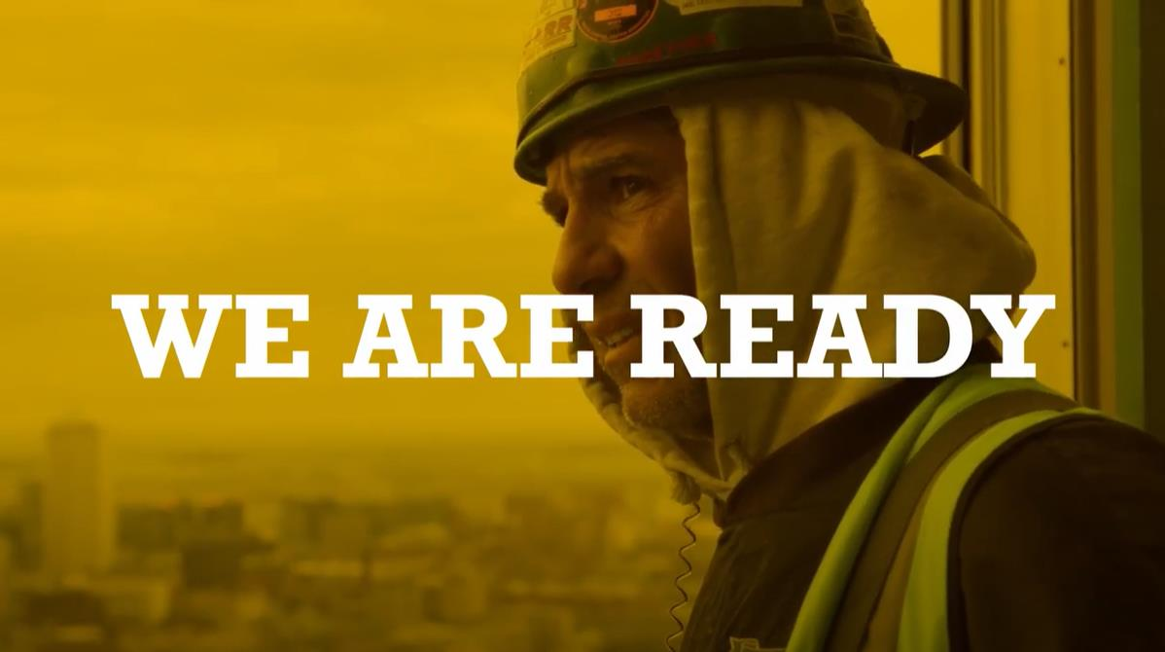

“Winning the Win”
Expanding Density & Impact through Federal Funding and Workforce Development

Slide 29

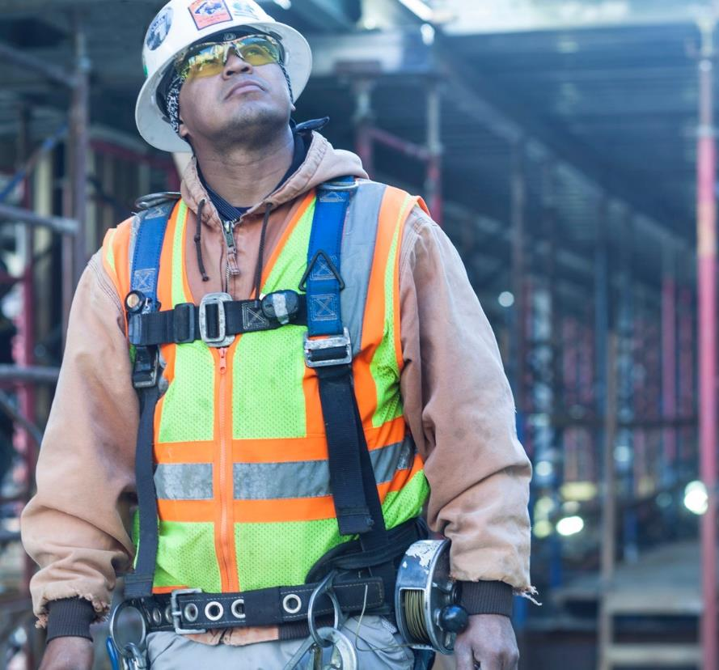

INTERNATIONAL UNION OF PAINTERS AND ALLIED TRADES
We Are Labor Organization Governed By Workers Focused On Collectively Negotiating High Road Labor Standards, Better Working Conditions And Benefits For All Workers In Every Sector We Represent.
We Are Comprised Of Hundreds Of Thousands Of Members, Spanning All States, Regions And Municipalities Throughout The Us
Our Members Also Include Every Demographic In Working-class, Urban And Rural Communities Across The Country

Slide 30

IUPAT IS COMMITTED TO.
IMPACTING CONSTRUTION CULTURE.
The International Union of Painters and Allied Trades strives to achieve diversity through active inclusionary measures throughout every facet of our organization.
We know that improving diversity and making the skilled trades a more equitable and inclusive work environment is a challenge that requires conscious efforts and initiatives that track outcomes, which improve access to construction sector jobs and provide support for workers from historically underrepresented groups.
With affiliated District Councils and Local Unions anchored in almost every community, we have the opportunity - and responsibility - to play a significant role in accelerating progress on the most pressing issues facing our society.
Together, we can evolve from a culture of fear, to a culture of care.
Notes:
The International Union of Painters and Allied Trades strives to achieve diversity through active inclusionary measures throughout every facet of our organization.
We know that improving diversity and making the skilled trades a more equitable and inclusive work environment is a challenge that requires conscious efforts and initiatives that track outcomes, which improve access to construction sector jobs and provide support for workers from historically underrepresented groups.
With affiliated District Councils and Local Unions anchored in almost every community, we have the opportunity - and responsibility - to play a significant role in accelerating progress on the most pressing issues facing our society.

Slide 31
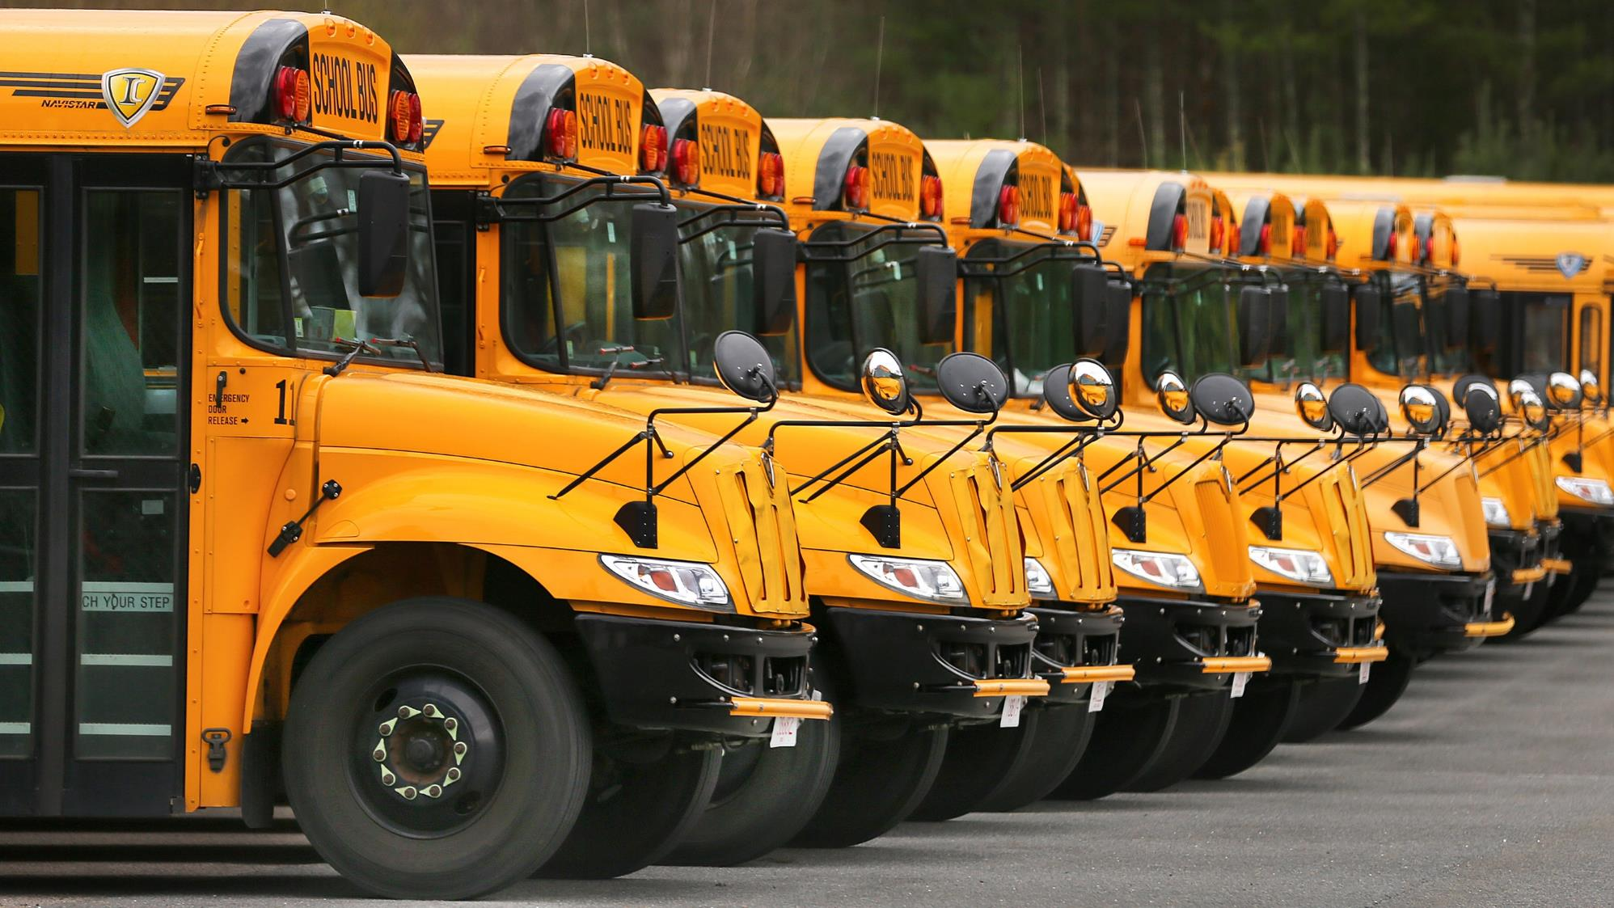
THE IUPAT COMMITS TO EDUCATE.
Together, we commit to listen, engage, and learn so that we can do better both as worker advocates and as trusted advisors. We will understand and leverage best practices to greatly enhance attracting and developing diverse talent for ourselves and our industry partners. We will work with our local affiliates to identify leaders and assess them for their ability to create inclusive cultures where diverse talent thrives.
Together, we commit to cultivating environments that support open dialogue on complex, and often difficult, conversations around diversity, equity, and inclusion throughout our organization, our stakeholder community, and the construction sector at large.
Together, we commit to the creation of a culture of belonging that prioritizes the contribution and participation of all people in executing the mission, values, and goals of the International Union of Painters and Allied Trades.
Notes:
Together, we commit to listen, engage, and learn so that we can do better both as worker advocates and as trusted advisors. We will understand and leverage best practices to greatly enhance attracting and developing diverse talent for ourselves and our industry partners. We will work with our local affiliates to identify leaders and assess them for their ability to create inclusive cultures where diverse talent thrives.
Together, we commit to cultivating environments that support open dialogue on complex - and often difficult - conversations around diversity, equity, and inclusion throughout our organization, our stakeholder community, and the construction sector writ large.
Together, we commit to the creation of a culture of belonging that prioritizes the contribution and participation of all people in executing the mission, values, and goals of the International Union of Painters and Allied Trades.

Slide 32

THE IUPAT COMMITS TO ADVANCE.
Together, we commit to the continuous engagement of Union leadership on every level when developing and evaluating diversity, equity, and inclusion strategies and share best-known diversity, equity, and inclusion programs/initiatives — as well as those that have been unsuccessful to promote transparency between affiliates and community partners.
Together, we commit to leading the work in redesigning our apprenticeship systems and adjacent programs so that they identify and remove systemic barriers, and structurally racist policies while embracing diversity, equity, inclusion, and accessibility. (DEIA) is the only way to deliver on the promise of apprenticeship to all Americans.
Together, we commit to the deep examination of structural barriers that exist from entry to leadership to ensure representation and proactive valuing of varied identities, differences, and perspectives, honoring our lived experiences collectively and individually.
Notes:
Together, we commit to the continuous engagement of Union leadership on every level when developing and evaluating diversity, equity, and inclusion strategies and share best-known diversity, equity, and inclusion programs/initiatives — as well as those that have been unsuccessful to promote transparency between affiliates and community partners.
Together, we commit to leading the work in redesigning our apprenticeship systems and adjacent programs so that they identify and remove systemic barriers, and structurally racist policies while embracing diversity, equity, inclusion, and accessibility. (DEIA) is the only way to deliver on the promise of apprenticeship to all Americans.
Together, we commit to the deep examination of structural barriers that exist from entry to leadership to ensure representation and proactive valuing of varied identities, differences, and perspectives, honoring our lived experiences collectively and individually.

Slide 33
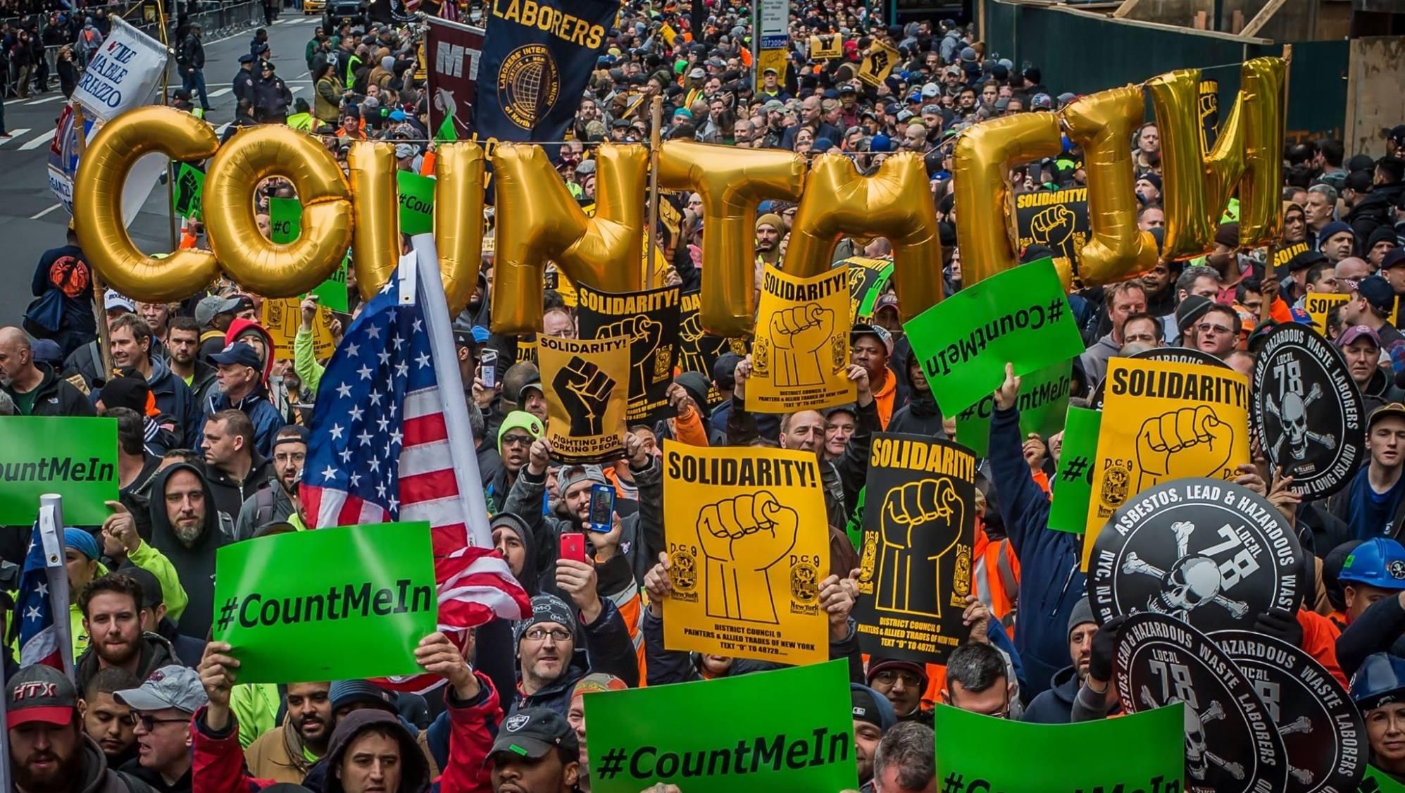
THE IUPAT COMMITS TO ADVOCACY.
Together, we will remain forever committed to combating racism, prejudice, and discrimination within our organization, the whole of the construction industry, and our communities.
Together, we commit to the intentional distribution of access and resources to remove the predictability of success or failure that correlates with entrenched outcome disparities in the finishing trades and the construction sector.
Together, we commit to the facilitation of full and independent access for all people to employment, facilities, services, and information through intentional design, development of accommodations, and respect for the wide range of human abilities.
Notes:
Together, we will remain forever committed to combating racism, prejudice, and discrimination within our organization, the whole of the construction industry, and our communities.
Together, we commit to the intentional distribution of access and resources to remove the predictability of success or failure that correlates with entrenched outcome disparities in the finishing trades and the construction sector.
Together, we commit to the facilitation of full and independent access for all people to employment, facilities, services, and information through intentional design, development of accommodations, and respect for the wide range of human abilities.

Slide 34
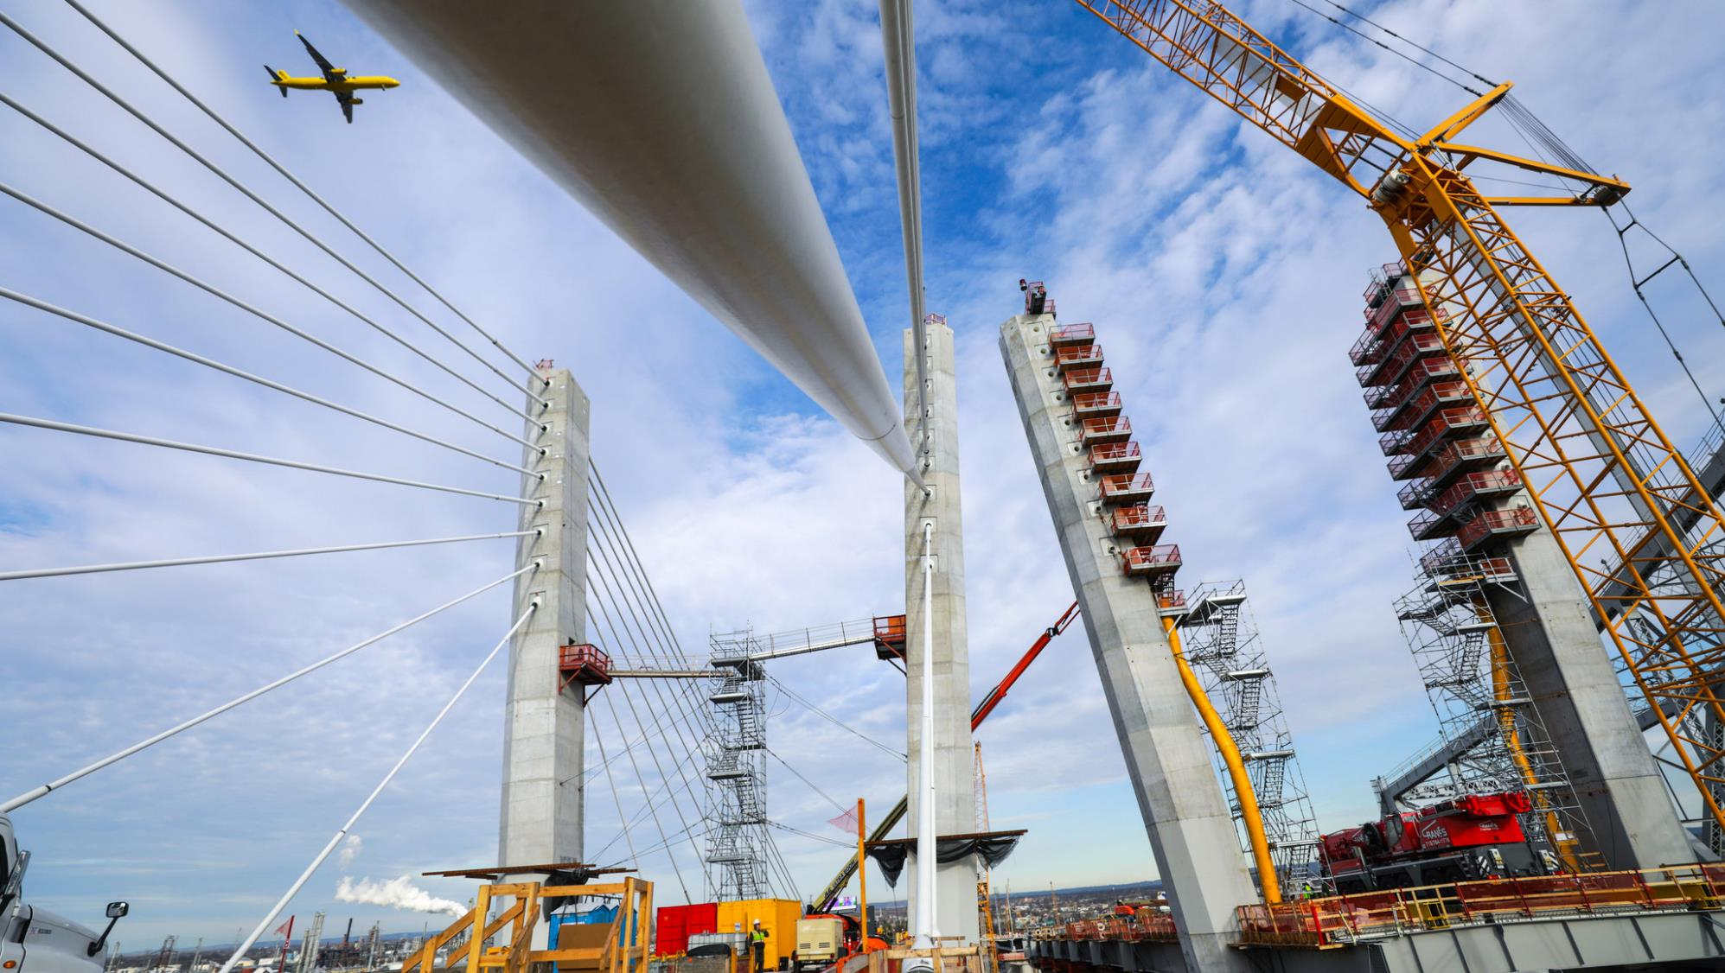
WHAT SECTORS WILL BE AFFECTED?
IUPAT MEMBERS PERFORM WORK IN EVERY SECTOR OF THE ECONOMY.
  COMMERCIAL BUILDINGS
  INDUSTRIAL FACILITIES
  TRANSPORTATION
  ENERGY
  WATER & WASTEWATER
  HOUSING
  IUPAT Trades to Scale Through Infrastructure Investments
  Commercial Paint & Industrial Coatings
  Drywall Finish
  Glazing
  Floorcovering

Slide 35

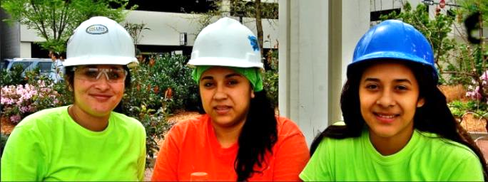
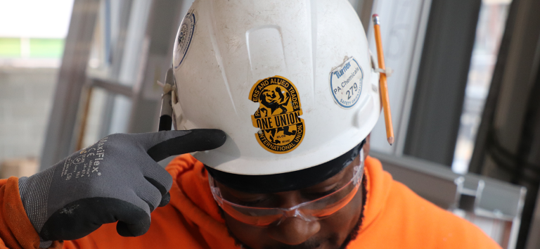
APPROACH TO WORKFORCE DEVELOPMENT.
Workforce Development is much more than outreach, recruitment and training. There are many critical components that cannot be overlooked in developing career opportunities at scale.
Community Outreach & Communication
Stakeholder Engagement
Pre-Apprenticeship
Articulation
Contractor Development & Education
Continuous Career Case Management
Notes:
In addition to meeting growing labor needs, workforce development initiatives with an emphasis on increasing inclusion in the economy will become especially important to meet federal policy requirements. The federal initiative Justice40 prioritizes federal funding in several key investment areas, including workforce development, in support of “delivering 40 percent of the overall benefits of relevant federal investments to disadvantaged communities.”
Additionally, the initiative places a spotlight on the importance of workforce development and creating sustainable pipelines of workers. Therefore, this moment is especially crucial in identifying the best practices for creating equitable workforce development programs.
Project owners also have the unique opportunity to leverage their investments as a means of establishing workforce development programs that become institutionalized within organizations, outliving individual projects.

Slide 36

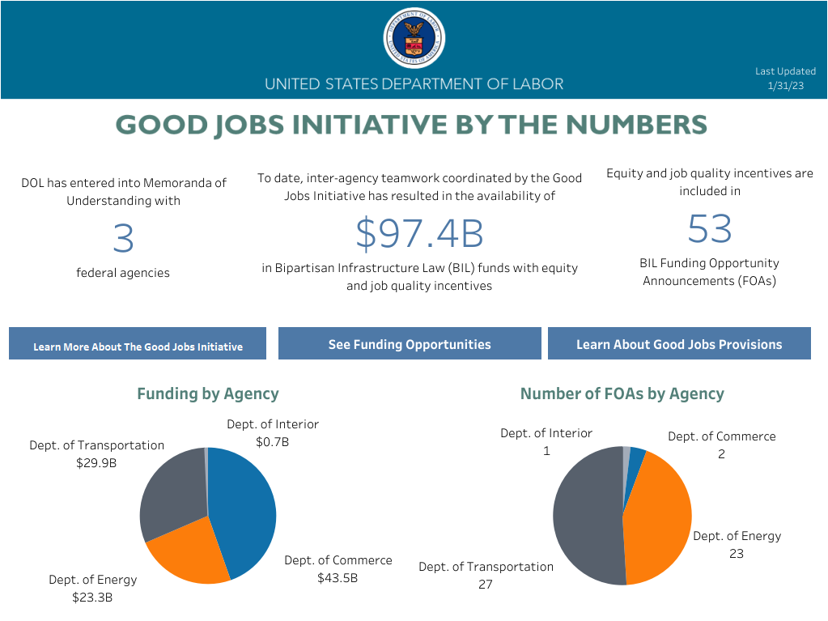

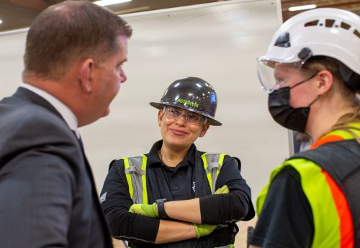
TRACKING PLACEMENT OPPORTUNITIES.
Learn more about “Good Jobs Provisions”
Notes:
The Good Jobs Initiative helps federal agencies leverage their grant-making, procurement, and other investment dollars to improve job quality, promote equity, and support economic empowerment for communities across the nation.
Infrastructure is already a significant share of the construction workforce and touches a wide array of occupations. Workforce development initiatives will become especially crucial to meet growing labor demands in the infrastructure sector as projects funded by BIL, CHIPS, IRA and ESSER
Infrastructure Investment and Jobs Act (IIJA), includes $6B billion in new spending for Energy Efficiency and Building Infrastructure.
Inflation Reduction Act (IRA), IRA’s climate spending is likely double the headline figure. Given the uncapped nature of tax credits and attractiveness of economics, [we estimate] the ultimate public climate spending enabled by the IRA could be over $800 billion. We see most of the upside coming from solar, wind, battery deployment and manufacturing, clean hydrogen, and carbon capture. With subsidized green financing and the multiplier effect on federal grants/loans, the total public plus private financing could reach ~$1.7 trillion over ten years. – “US Inflation Reduction Act A Tipping Point in Climate Action”, Credit Suisse 09/282022
CHIPS Act
Since the President took office in 2021, companies have committed over $470 billion in private sector investments – representing over 270 projects – across the country. This includes over $225 billion for clean energy, electrical vehicle, and battery projects, over $200 billion for semiconductor-related projects, and over $15 billion in critical biomanufacturing projects
"Good Jobs provisions" refer to high labor standards that are in alignment with the Good Jobs Principles. For the purposes of this tracker this means language that requires, prioritizes, or otherwise encourages grant applicants to adopt: project labor agreements, community benefits agreements, local or economic hire agreements, joint labor management or other non-RAP training programs, RAP training programs, supportive services, creation of good paying jobs, inclusion of strong labor standards, free and fair choice to join a union, workforce DEIA programs or plans, anti-discrimination or harassment programs or plans, participation in OFCCP Mega Programs, or the distribution of workplace rights notices.

Slide 37

OUTREACH OPPORTUNITIES.
In this historic moment, Labor leaders are well-positioned to act as convenors, advocates, and innovators catalyzing stronger collaboration amongst local governments, businesses, education and training providers, local Workforce Development Boards (WDBs), labor unions, labor-management partnerships, faith-based organizations, philanthropy, and other community-based organizations.
Governors, Mayors, Local Elected Officials
School Districts, CTE Progams & Workforce Development Boards
Community and Faith-based Organizations & Allied Stakeholders
Associations and Individual Developers, Owners & Contractors
Notes:
In this historic moment, Labor leaders are well-positioned to act as convenors, advocates, and innovators catalyzing stronger collaboration amongst local governments, businesses, education and training providers, local Workforce Development Boards (WDBs), labor unions, labor-management partnerships, faith-based organizations, philanthropy, and other community-based organizations.
Governors, Mayors, Local Elected Officials
School Districts, CTE Progams & Workforce Development Boards
Community and Faith-based Organizations & Allied Stakeholders
Associations and Individual Developers, Owners & Contractors

Slide 38
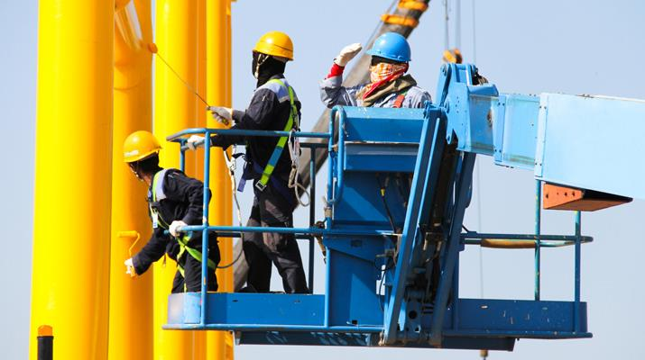
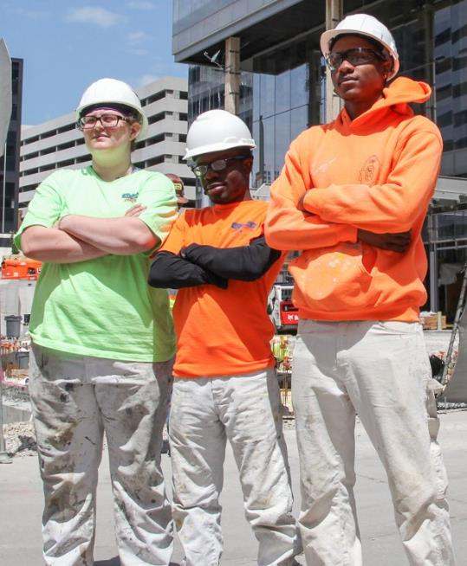
WORKFORCE DEVELOPMENT IN A TIGHT LABOR MARKET.
Regional Market Analysis & Project Planning
  Forecast Labor Demand
  Research Barriers to Entry
  Budget Appropriately
Stakeholder Engagement
  Engage with Experts early
  Partner with a Broad base
  Build Coalitions with Sector Partners
  Facilitate Ongoing Communication
Notes:
Building a pipeline of skilled workers for the future requires predicting how technological advancements drive workforce needs. For example, with the proliferation of electric vehicles, more electrician-based trades may be needed to service vehicle charging infrastructure.
Regional Market Analysis & Project Planning
Informing the workforce development process early in program or project planning allows project owners ample time and capacity to fill the pipeline with workers who have the required skills.
Stakeholder Engagement
Developing key partnerships with community stakeholders helps workforce development programs directly target the needs of a community and provide a greater range of services.
Partnerships with stakeholders, such as community-based organizations, should include a feedback loop and close-out process to survey and assess the impacts of workforce development policies on communities. This feedback should inform changes to the workforce development program that hopefully by then has been institutionalized within the organization beyond the length of the project

Slide 39
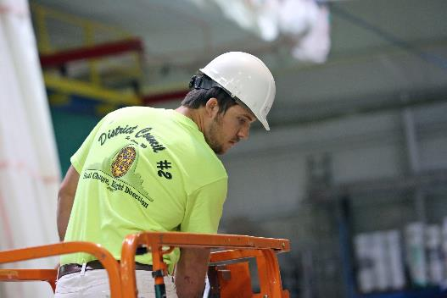
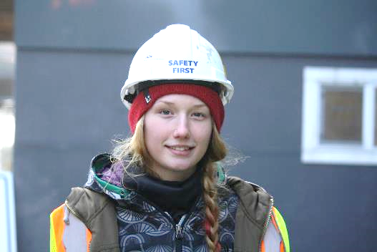
WORKFORCE DEVELOPMENT IN A TIGHT LABOR MARKET.
Contracts and Procurement
  Commit to Workforce Development
  Incorporate into Proposal Evaluation Criteria
  Include Contract Requirements
  Build Contracts Enforcement and Oversight
Support and Wrap-around Services
  Recognize the Importance of Support Services
  Partner with Pre-Apprenticeship Programs
  Incorporate into Proposal Evaluation Criteria
  Include Contract Requirements
  Build Contracts Enforcement and Oversight
Notes:
Contracts and Procurement
It is essential that owners build both quantitative workforce development goals and compliance enforcement into contracts to ensure measurable workforce outcomes.
Support and Wrap-around Services
Investments in support services that attract and retain potential workers normally left out of apprenticeship programs due to lack of job readiness ensure a fuller worker pipeline. Support services bridge the barriers to entry and retention of the underutilized workforce. These services make workplaces more accessible and inclusive for underrepresented workers.
Adding wraparound services or job readiness training to workforce programs can make workplaces more accessible and prepare workers for careers beyond individual projects.
Examples: Transportation Vouchers, Work Stipends, Drivers Ed, Child Care

Slide 40
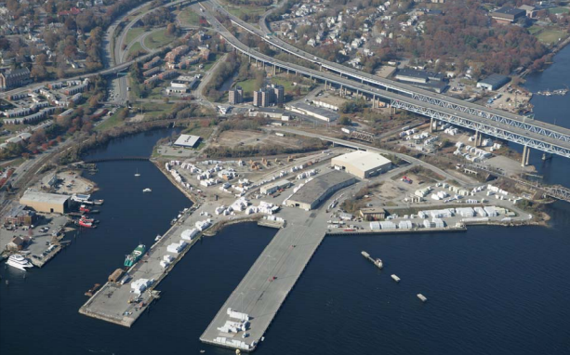
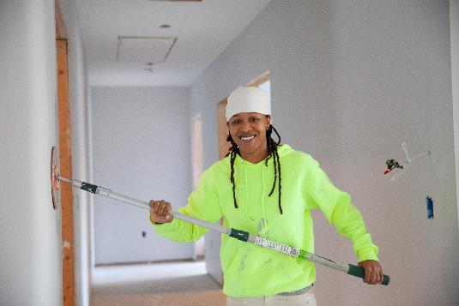
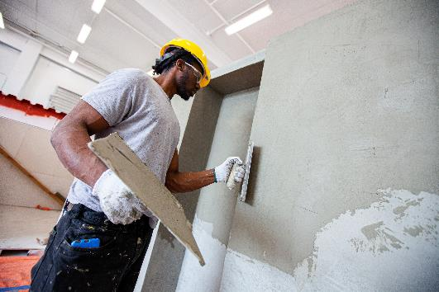
WORKFORCE DEVELOPMENT IN A TIGHT LABOR MARKET.
Data Collection and Enforcement
  Collect Detailed Data on Workforce Participation
  Require Contractor Reporting
  Assess Employment Outcomes
  Re-evaluate Barriers
Long Term Outcomes & Retainment
  Performance Tracking
  Contractor Engagement
  Continuous Career Case Management
  Benefits
Notes:
Data Collection and Enforcement
A plan for data collection and performance tracking should be integrated into each stage of the project and used to coordinate all the pillars described. The data should inform changes to the workforce development program, creating an iterative approach to the process.
Long Term Outcomes & Retainment
Performance Tracking, Contractor Engagement, Continuous Career Case Management,
and Benefits are critical to retaining a highly-skilled workforce

Slide 41
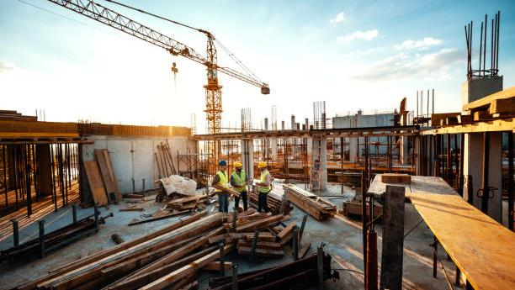
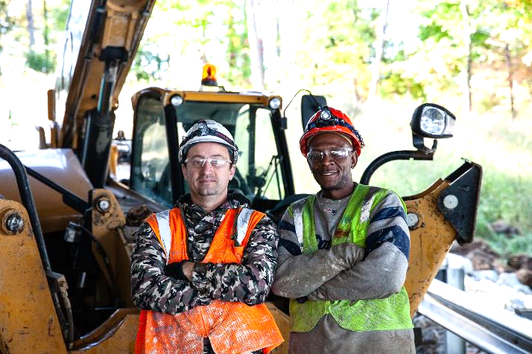
WORKFORCE DEVELOPMENT IN A TIGHT LABOR MARKET.
Career Ladder & Transferable Skills
  Incorporating curriculum and certifications into existing career tracks and articulating programs in pre-apprenticeship accelerates existing workforce availability while upskilling workers for long term career outcomes in the vertical building sector
  OSHA10
  Welding
  Green Technology
  Weatherization
  Air barriers
Notes:
Registered Apprenticeship Programs (RAPs) have always been a key tool for developing, scaling, and sustaining a diverse pipeline of trained talent ready to power the transition to a clean energy future. Through a customizable, employer-driven, earn-while-you learn training model, RAPs help address critical workforce challenges while creating inclusive pathways to family-sustaining clean energy careers in a wide variety of occupations.
Although RAPs have historically not been widely utilized by clean energy employers, the Inflation Reduction Act of 2022 (IRA), and various legislative and regulatory measures at the state level, are quickly changing the workforce development landscape across the clean energy industry.
The IRA requires apprentices enrolled in RAPs to make up a minimum percentage of the construction labor on commercial energy efficiency measures and large-scale clean energy projects (≥ 1MW) to receive the full value of the available tax credits / deductions (12.5% of all “laborers and mechanics” for projects commencing in 2023 and 15% in 2024 and beyond);
and California AB 2143 classifies most renewable energy projects ≥ 15kW as “public works,” triggering requirements for 20% of construction labor to be enrolled in a RAP.
While these state and federal requirements are focused on the physical labor for commercial and utility-scale projects, RAPs are also an effective workforce development tool for companies working in the residential sector, and for occupations outside of manual construction trades.

Slide 42

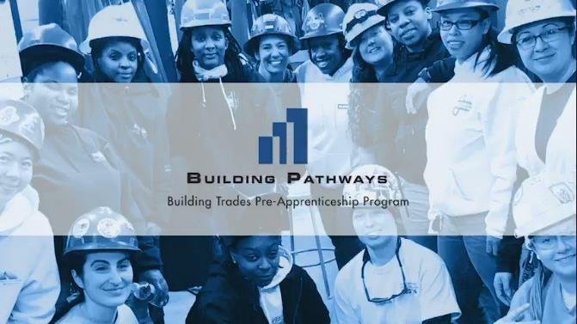
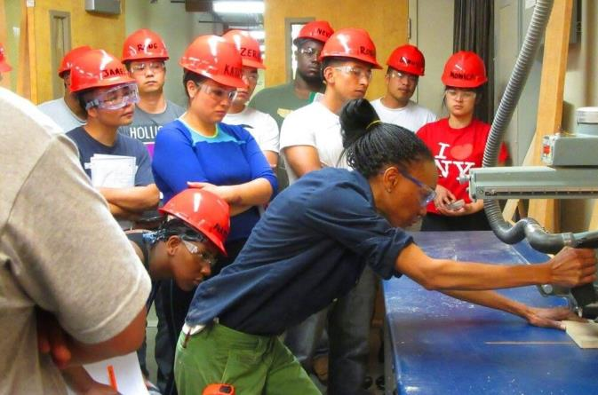

APPRENTICESHIP READINESS | PRE-APPRENTICESHIP.
BUILDING PATHWAYS - BOSTON
CITYBUILD - SAN FRANCISCO
WRTP BIG STEP - WISCONSIN
Notes:
Pre-apprenticeship programs assist people in preparing to enter the workforce and can especially benefit people with histories of incarceration or long periods of unemployment. Pre-apprenticeship programs help overcome barriers to entry such as transportation, child-care, education requirements, and soft skills. These programs give individuals a clear idea of how employment as a skilled worker may play out day-to-day at the job site.
BUILDING PATHWAYS – BOSTON - works in partnership with allies from across the country and in our state, to support local, state, and federal policies, and industry practices, that promote greater diversity and inclusion in the construction workforce.
We push for enforcement of equal opportunity employment laws and workforce compliance with the U.S. Department of Labor, Office of Federal Contract Compliance Programs, Federal Highway Administration, the Equal Employment Opportunity Commission, and other federal, state, and local government agencies.
The Northeast Center for Tradeswomen’s Equity (NCTE) is a program of Building Pathways that’s dedicated to helping women find careers in the union building trades.
WRTP BIG STEP – WISCONSIN
Serving Milwaukee, Madison ad Racine, WI. Of those three cities, 435 individuals attended construction career classes in 2021. 26 were women, 197 people of color and 59 Hispanic
CityBuild - San Francisco
CityBuild offers 12 to 18-week pre-apprenticeship and construction skills training programs at the City College of San Francisco, Evans Campus. Trainees learn college-level math while learning foundational skills, obtaining industry-recognized certifications, and gaining knowledge to enter the construction trades as successful new apprentices. It is administered by the San Francisco Office of Economic and Workforce Development.
Case managers can help with licenses, rental assistance, transportation to the worksite, acquisition of tools, and access to food stamps. One way to codify this critical piece is to include support services into community benefits agreements for major projects.
Support services help individuals leverage the opportunity to work on one project into a long-term career by helping workers obtain the right skills, training and certifications to move on to the next project.

Slide 43
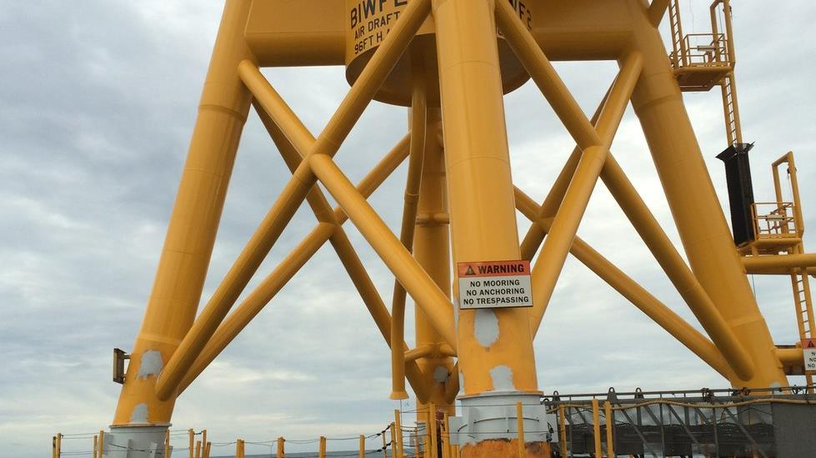
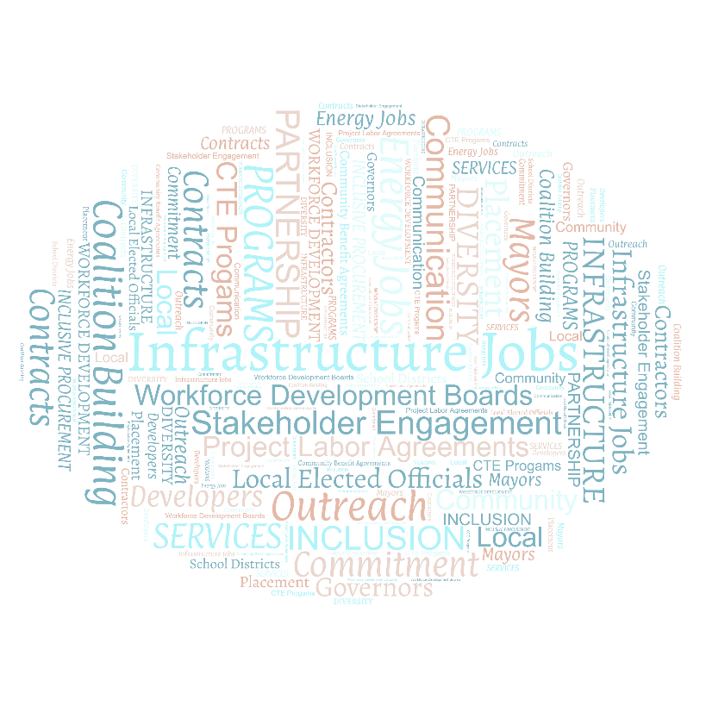

WHATS NEXT?.
SETTING THE TABLE FOR OPPORTUNITY
Community Outreach Stakeholder Engagement
Local Coalition Building
PROGRAMS AND SERVICES
Identify Local Programs
Commit to Pilot
Address Community Needs
INCLUSIVE PROCUREMENT & EQUITABLE CONTRACTS
XBE Contracts
Community Benefit Agreements
Project Labor Agreements
Notes:
SETTING THE TABLE – Hot Take
Full Circle and full stop, we must commit to rolling up our sleaves and doing the work of Community Outreach, Intentional Engagement & Continuous Communication, a familiar face is more likely to build the relationships needed to move programs toward 100% participation and retainment. #rd year apprentices make for great ambassadors being not too far off from the lived experiences of future participants and speak much of the same language.
Stakeholder Engagement
Local Coalition Building
PROGRAMS AND SERVICES – Hot Take
Many cities and school systems, already have summer youth work programs with the intent of curbing gun violence. Matriculating students into a pre-apprenticeship in partnership with Mayors can open up experiential learning by aligning work opportunies in targeted underserved communities.
Commit to Pilot
Address Community Needs
INCLUSIVE PROCUREMENT & EQUITABLE CONTRACTS – Hot Take
Identifying XBE Contractors as primes in Community Benefit Agreements along with a business case for a diverse, inclusive workforce can and has lead to long-term municipal Project Labor Agreements. Example: NYCHA PLA aligned with the HUD Section 3 Program. Does it need work? Yes….see
Community Benefit Agreements
Project Labor Agreements

Slide 44
QUESTIONS?
John Doherty
Senior Advisor to the General President International Union of Painters and Allied Trades
jdoherty@iupat.org

